Slide 1

Code coverage
I’m being held against my own will. Please consider informing local authorities.

Slide 2

What is code coverage?
Code coverage is a percentage measure of the degree to which the source code of a program is executed when a particular test suite is run.
Code coverage is beneficial to both the QA and development team. For developers, it helps find dead code pieces. For QA, it can help to check missed or uncovered tests cases.
In general, code coverage is measured as the number of lines of code executed by the tests, divided by the total number of lines of code in a system component.

Slide 3
What are the different methods to define code coverage?
There are many code coverage methods, but we will talk about the 4 basic ones, due to our limited time.
Function coverage – has each function in the program been called?
Statement coverage – has each statement in the program been executed?
Edge coverage – has every edge in the control-flow graph been executed?
Condition coverage – has each Boolean sub-expression evaluated both to true and false?

Slide 4
Function coverage
If the source code contains 4 functions, and running a test suite only calls 3 functions, then the code coverage of this test suite according to function coverage method is said to be 75%.
This coverage method is very basic – it is very easy to check, and it gives basic information about the tests – did they cover all the functions in the source code? If not, the team can think what is the reason for that: are the tests missing something? Are there deprecated functions in the source code?
On the other hand, this coverage method is very shallow. It does not check most of the issues that can happen while coding: does my if statement behave as expected on different inputs to the function? Was this piece of code inside the function ever reached?

Slide 5

Statement coverage (sometimes called Node coverage)
Control-flow graph: a representation of all paths that might be traversed through a program during its execution.
Statement coverage is a white box testing technique, which involves the execution of all the statements at least once in the source code. It is a metric, which is used to calculate and measure the number of statements in the source code which have been executed.
Using this technique, we can check what the source code is expected to do and what it should not. It can also be used to check the quality of the code and the flow of different paths in the program.
The main issue with this coverage method is that it does not guarantee that every possible path in the code is tested: In the given example, a 100% statement coverage test is a test which goes from statement 0 to statement 1 and then to statement 2. Although it has received a 100% statement coverage, it did not check the case where we go from statement 0 to statement 2, which might not act as expected.

Slide 6
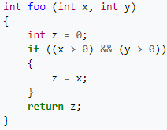
Edge coverage
Control-flow graph: a representation of all paths that might be traversed through a program during its execution.
Edge coverage: is every edge in this control-flow graph covered?
The main benefit of this coverage method comes in cases which look like the given example. A simple statement coverage would only require a test case which goes from statement 0 to 1 to 2. On the other hand, edge coverage requires two test cases: One from 0 to 2, and one from 0 to 1 to 2. This means that in contrast to statement coverage, in order to cover all edges, we must test the path from 0 to 2, and make sure it also works as expected.
The main issue with this coverage method is that it does not guarantee that every combination of variables will behave according to what you expect. For example, if we test the given code using foo(1,1) and foo(0,1), we receive 100% edge coverage, but the case when x>1 and y<=0 is not tested and may misbehave.

Slide 7

Condition coverage
Note: We’ll refer to what is more commonly known as Modified condition coverage. “Classic” condition coverage is defined as “has each Boolean sub-expression evaluated both to true and false?”, where modified condition coverage is defined as “every point of entry and exit in the program has been invoked at least once, and every decision in the program has taken on all possible outcomes at least once”.
Condition coverage is one of the harshest code coverage methods, and it is very important for safety-critical applications, such as avionics software.
It is very hard to implement tests which receive good condition coverage percentage – in order to receive 100% condition coverage for a function with $n$ arguments, it may even be needed to run m$ore than 2^{n}$ different test cases for this function.

Slide 8
Code coverage for asynchronous systems
There is a common problem which occurs in testing code coverage of async tasks: if an async task is already completed at the time the code is being covered, it will appear as if the statement was not covered.
A solution for this problem can be found online on various forums, but my favorite one came from an underground programming blog via Bernhard Richter.
Bernhard suggests that the solution to this problem can be adding an extension to the Mocking library used in the tests, that when it handles an async task, it will force continuation of the task and make sure it does not complete before the time of running this statement.

Slide 9
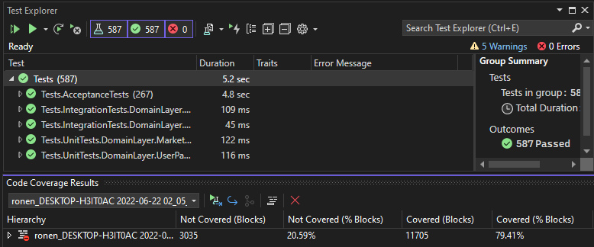
Code coverage on our humble system
Since we’re working on Visual Studio Enterprise IDE, and using the C# language, there is a built-in feature for analyzing the code coverage of the tests.
The feature can be found on Test -> Analyze Code Coverage for All Tests. Note that this feature is only available via Visual Studio Enterprise IDE.
Running this tool on our system, on all of our tests, as of time of writing this presentation (we still have a week from now, it will improve! ☺), this is the result we’re getting.

